Slide 1
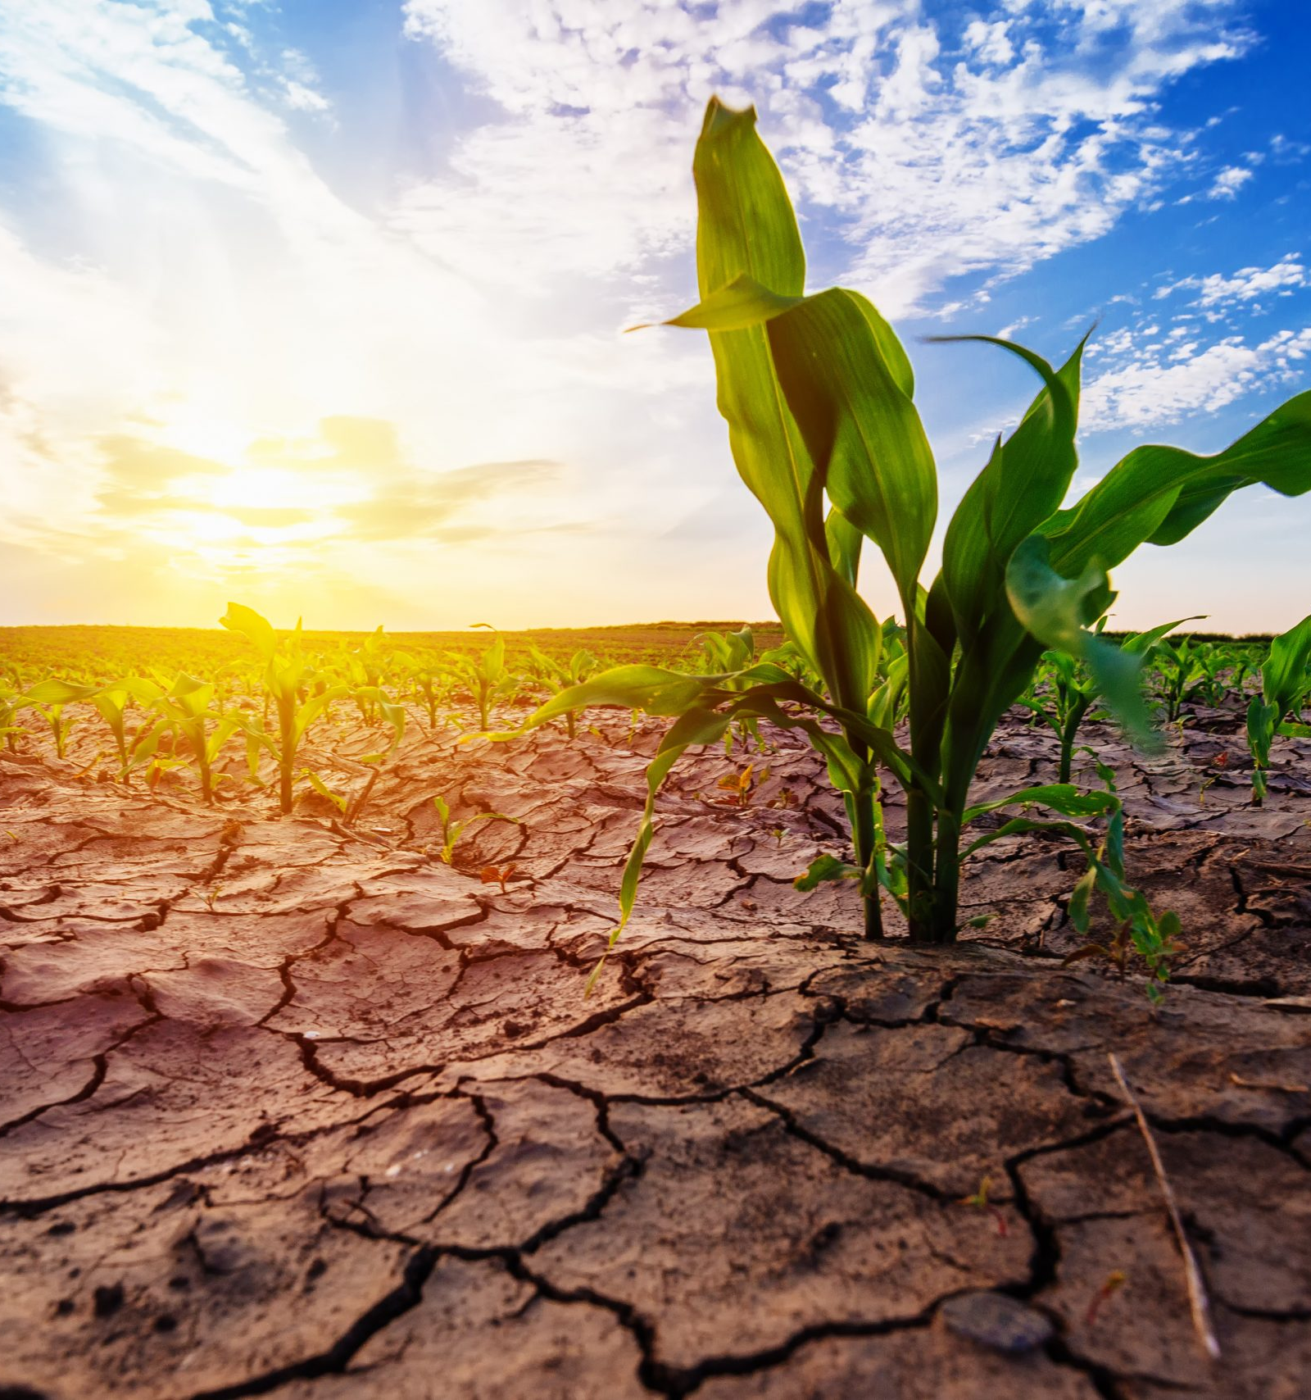
GGS 656 Hydrosphere Final Project Xiaoxuan Li March 1st ,2021
Prediction of Drought Index Based on Random Forest

Slide 2
Motivation
Drought is considered as one of the major natural hazards that affect the environment and economy at local and global scales. Considering local weather data is not sufficient to monitor and evaluate drought conditions, it is therefore important to include satellite images, climate data, and hydrologic information to predict the location and severity of droughts.
Hypothesis
Random forest model can accurately predict drought conditions across the US in a decade (2010~2020).
Objective
Implement RF algorithm to predict drought conditions in the US and identify important factors that affect droughts the most.
Compare RF with other machine learning algorithms (RF, SVM, ANN, GLM, RPART).

Slide 3
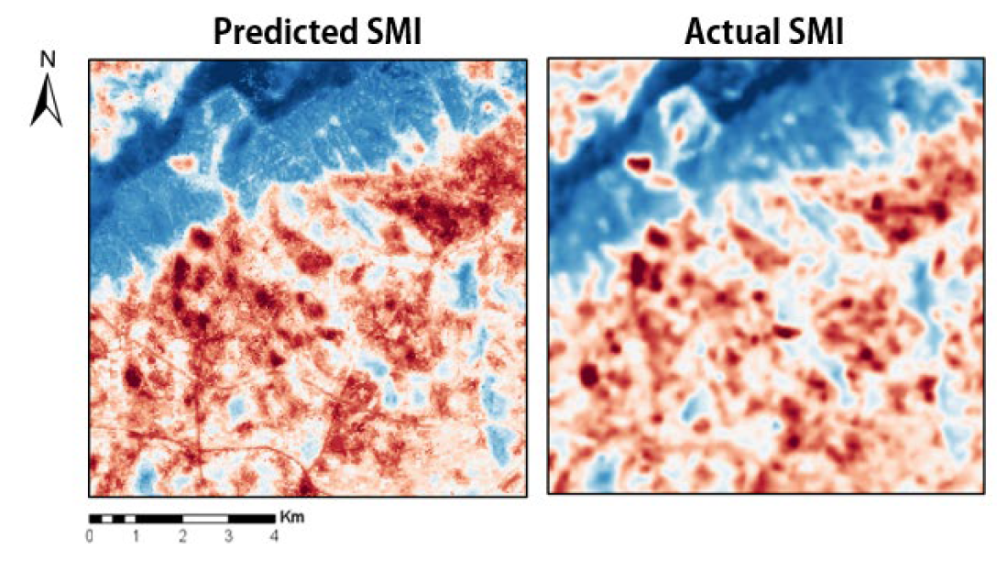
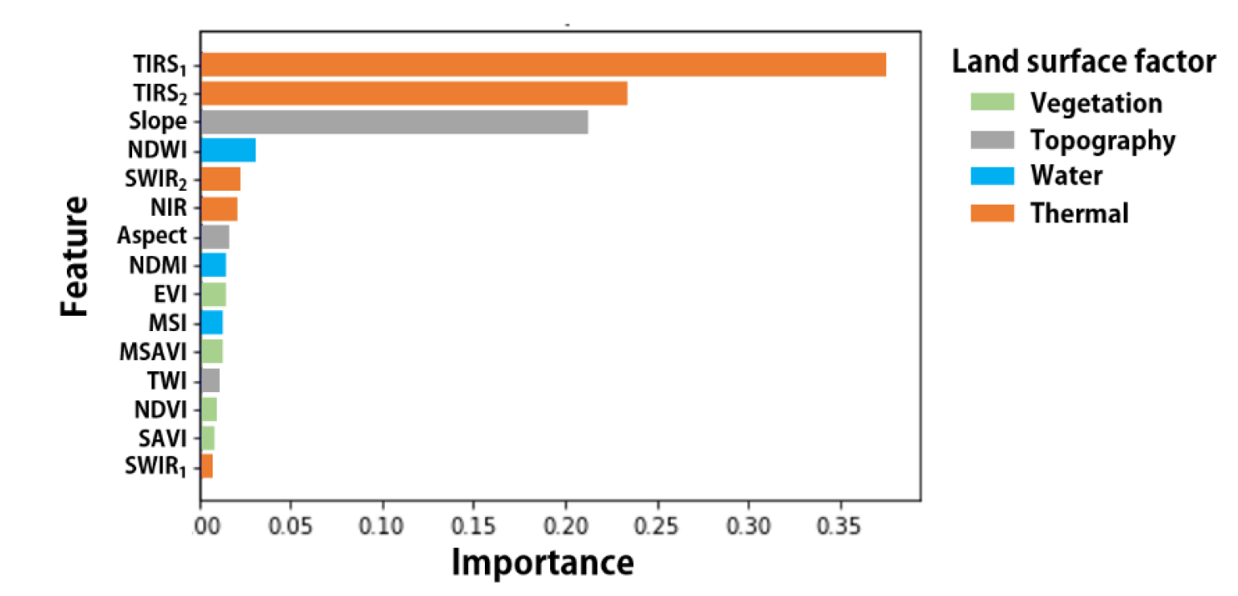
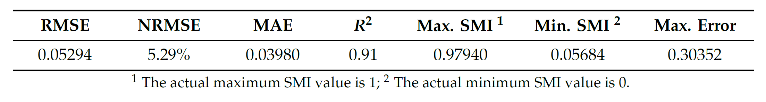
Literature review
Prediction of Severe Drought Area Based on Random Forest: Using Satellite Image and Topography Data [1]
Generated drought function with the RF algorithm using input variables and three months afterward SMI (drought index) to train agricultural drought.
Identified the order of feature importance that affects drought training (regression) among the input variables (features).

Slide 4
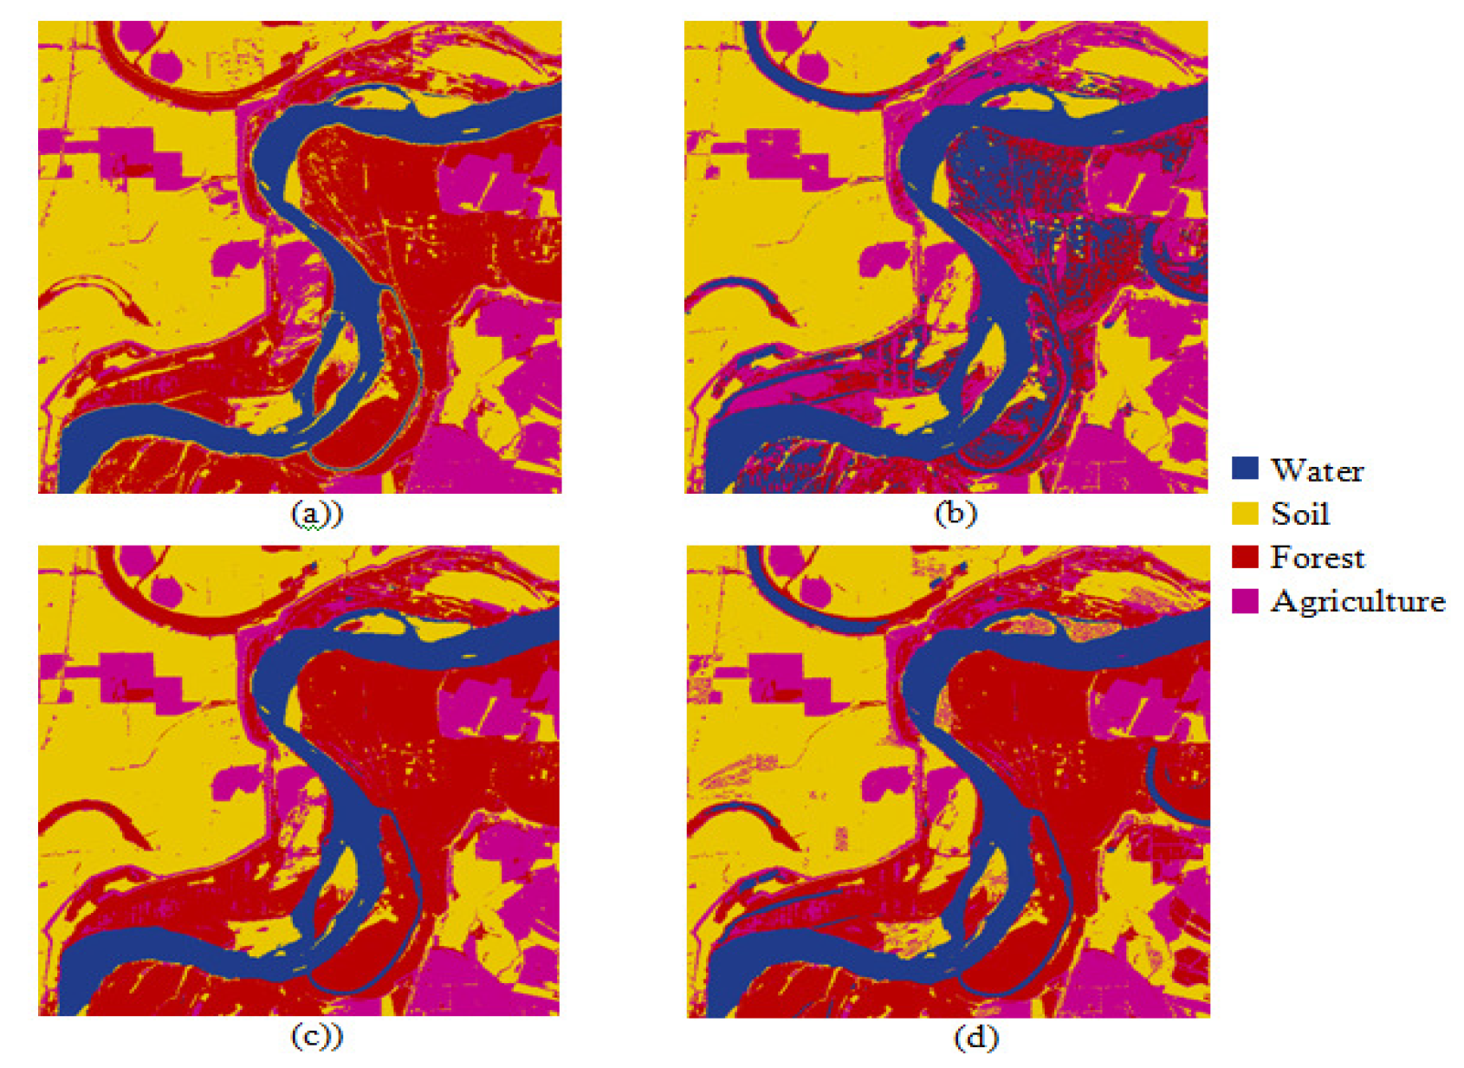
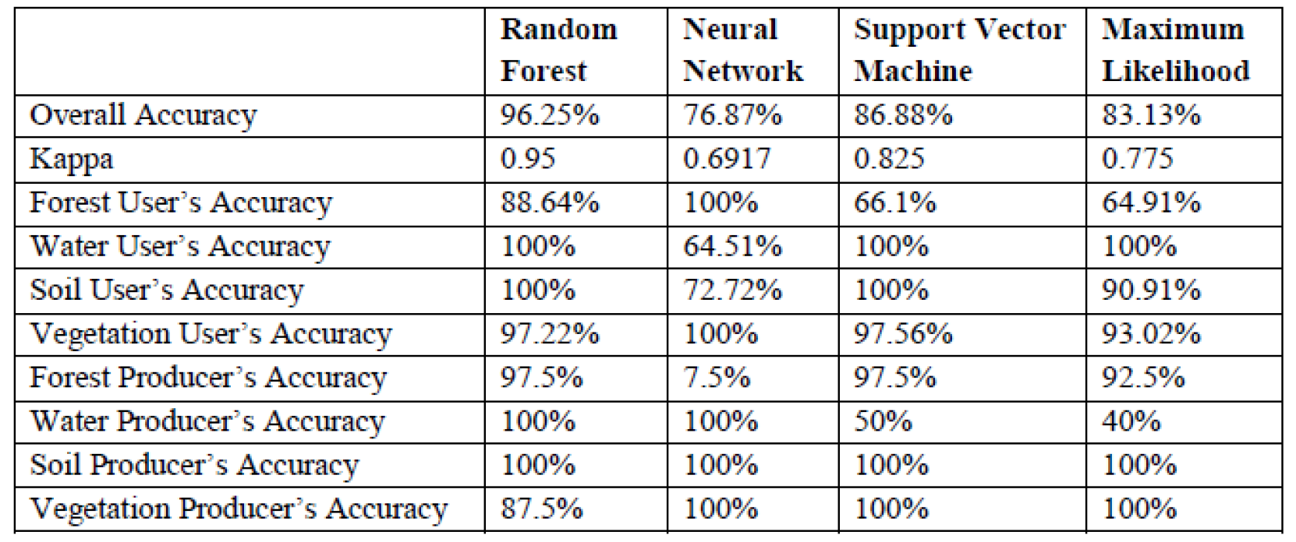
Literature review
MULTISPECTRAL IMAGE ANALYSIS USING RANDOM FOREST [2]
Introduced Random Forest Algorithms and provided implementation of Random Forest and examples of classification of pixels in multispectral images.
Compare performance of the Random Forest algorithm with other classification algorithms

Slide 5
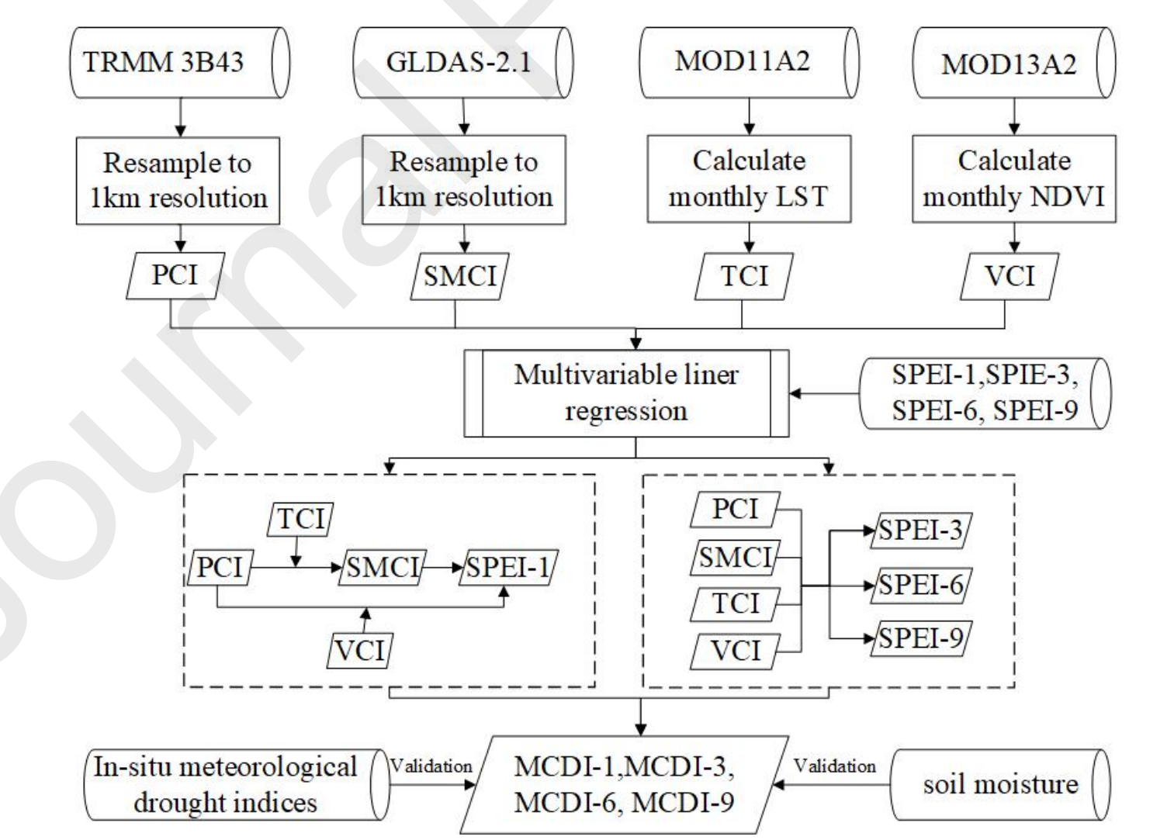
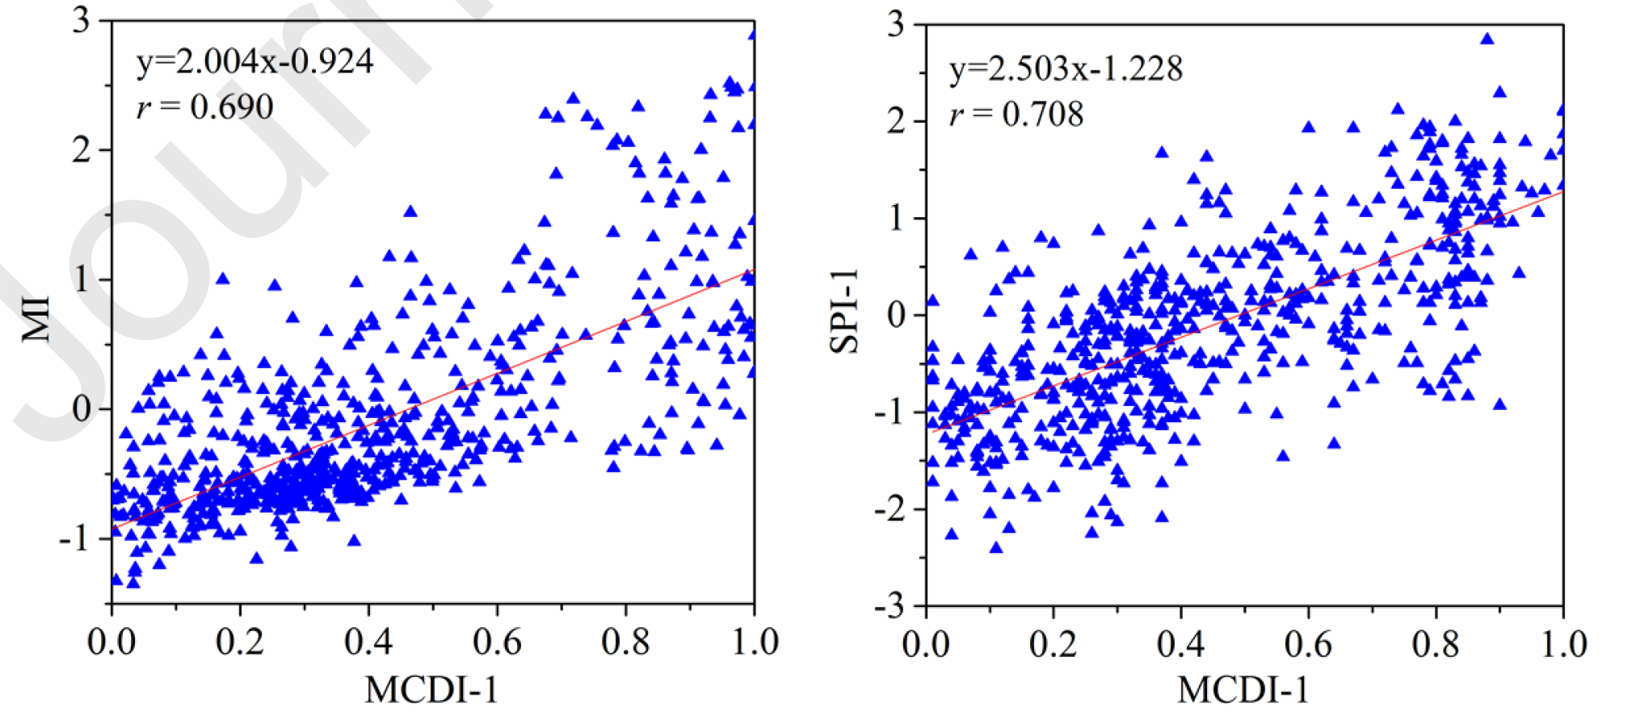
Literature review
Monitoring drought using composite drought indices based on remote sensing [3]
Established composited drought index compare the correlation coefficients between composite indices and SPEIs with that between single indices and SPEIs
Verified the ability of the composite index in monitoring meteorological drought and agricultural drought and investigated drought condition by in China over space and time.

Slide 6
Method
Time range: 2010~2020
Study area: the Contiguous USA
Tools: ArcGIS Pro, R
Table 1. Details of input variables
Variable (abbreviation) | Category | Dataset | Resolution (spatial/temporal) | Unit
Drought [4] | Drought | gridMET | 3980 m/daily | Index
NDVI [5, 6] | Vegetation | MODIS Terra 16 Days | 3980 m/16 days | Index
NDWI [7] | Vegetation | MODIS Terra/Aqua 16 Days | 3980 m/16 days | Index
EVI [8] | Vegetation | MODIS Terra 16 Days | 3980 m/16 days | Index
Temperature | Climate | gridMET | 4660 m/daily | Degree
Precipitation | Climate | gridMET | 4660 m/daily | Millimeters
Windspeed | Climate | gridMET | 4660 m/daily | Meters/second
Humidity | Climate | gridMET | 4660 m/daily | Grams/m³
Burn | Fire | gridMET | 4660 m/daily | Index
Soil Moisture | Hydrology | TerraClimate | 4660 m/monthly | Millimeter
Runoff | Hydrology | TerraClimate | 4660 m/monthly | Millimeter
Evapotranspiration | Hydrology | TerraClimate | 4660 m/monthly | Millimeter

Slide 7
Method
Fire
Drought
The rasters were clipped, resampled, georeferenced, and composited in ArcGIS Pro to ensure consistent spatial/temporal resolution for further processing.
All preprocessed rasters were then converted to R dataframe and normalized to (0,1) range for Random Forest (RF) prediction.
The whole R data frame was split to two parts: prediction datasets (70%) for training the random forest model, and testing datasets (30%) for validating the random forest model.
The Random Forest tree count was set to 100 to compromise between model performance and quality.
Several error measures were calculated to evaluate the performance of the RF model.
Compare performance of the RF algorithm with other machine learning algorithms
Data collection
Vegetation
Project
Climate
Clip
Hydrology
Data processing
Resample
Georeference
Feature engineering
Composite
Data
analysis
RF modeling
Importance
Errors
Model
comparison
RF
SVM
ANN
GLM
RPART
Figure 1. Flow chart

Slide 8
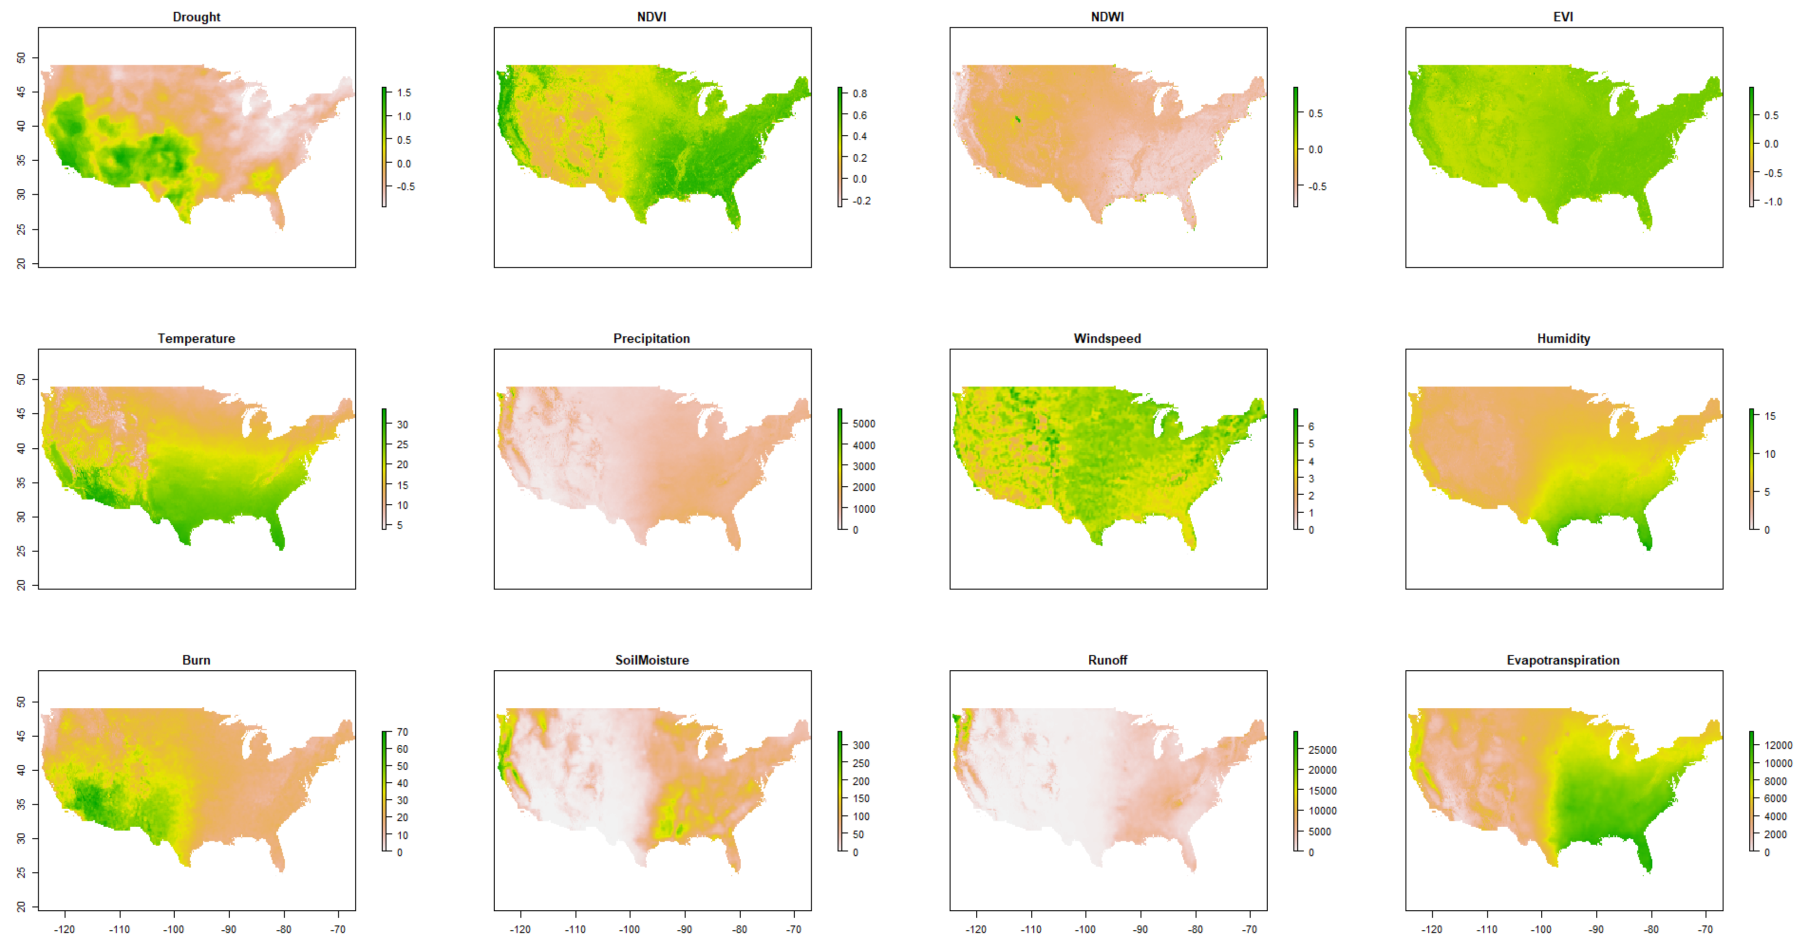
Figure 2. Thematic maps of drought related factors from 2010 to 2020(before normalization)

Slide 9
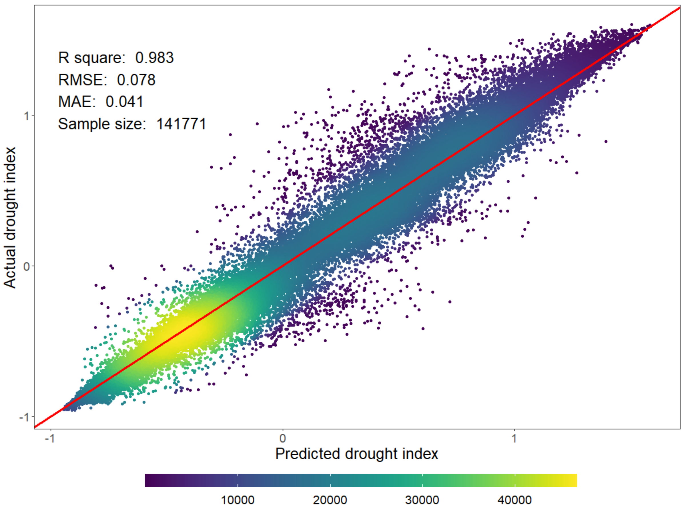
Result
Figure 3. Density plot of actual vs. predicted drought index

Slide 10
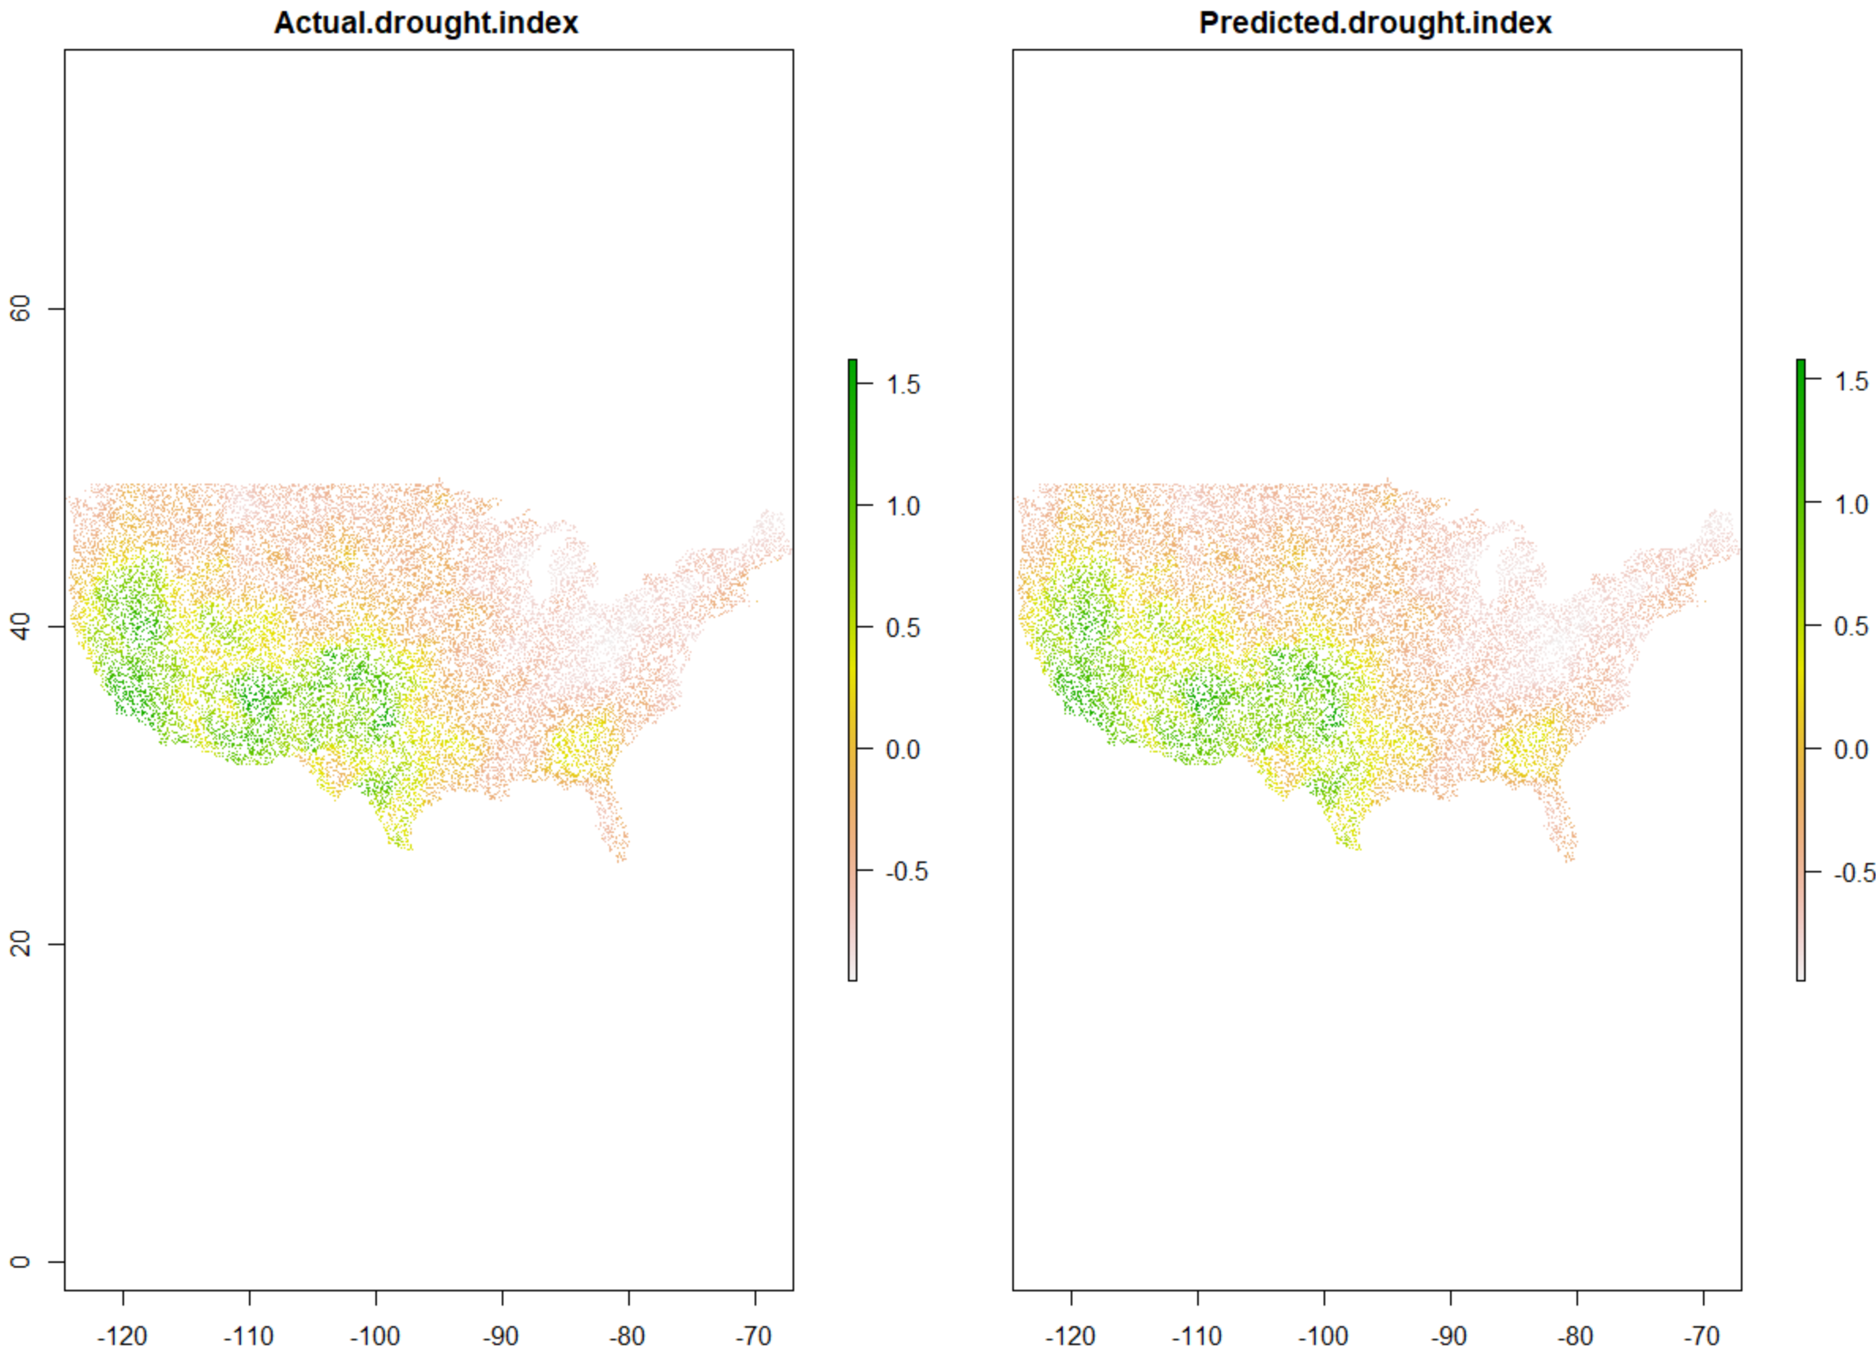
Result
Figure 4. Verification of the RF performance based on test datasets
(left: actual drought map; right: predicted drought map based on RF)

Slide 11
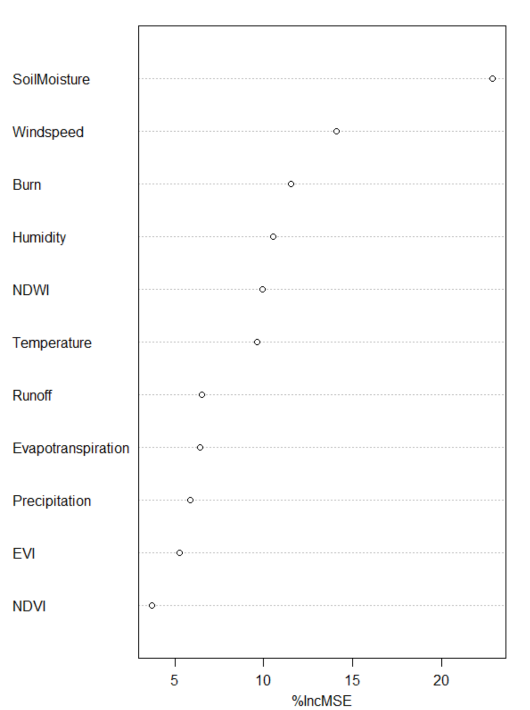
Result
%IncMSE is the most robust and informative measure, which shows how much the model accuracy decreases if we leave out that variable.
Top 3 important factor: soil moisture, windspeed, and burn index.
Figure 5. Importance plot of drought related variables

Slide 12
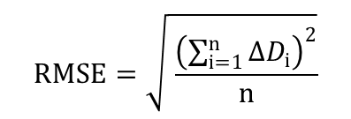
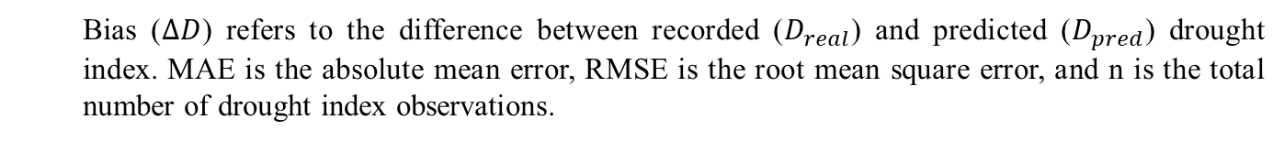
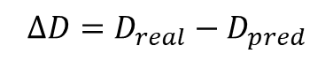
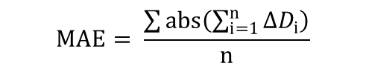
Result
$$RMSE=\sqrt{ \frac{{\left(\sum_{i=1}^{n}{{∆D}_{i}}\right)}^{2}}{n}}$$
$$∆D=D_{real}−D_{pred}$$
$$MAE= \frac{\sum{abs\left(\sum_{i=1}^{n}{{∆D}_{i}}\right)}}{n}$$
Bias ($∆D$) refers to the difference between recorded ($D_{real}$) and predicted ($D_{pred}$) drought index. MAE is the absolute mean error, RMSE is the root mean square error, and n is the total number of drought index observations.
Table 2. Comparison of machine learning algorithms
Method | R² | MAE | RMSE
RF [9] | 0.983 | 0.041 | 0.078
RPART [10] | 0.737 | 0.229 | 0.303
SVM [11] | 0.848 | 0.162 | 0.228
ANN [12] | 0.755 | 0.219 | 0.289
GLM [13] | 0.666 | 0.254 | 0.338
Note: machine learning methods listed above refer to Random Forest (RF, 100 trees), R Recursive Partitioning and Regression Trees (RPART), Support Vector Machine (SVM), Artificial Neural Network (ANN), Generalized Linear Models (GLM). To compromise between performance and quality, resample process was applied to some time-consuming algorithms like RF and SVM.

Slide 13
Discussion & Conclusion
RF and other machine learning algorithms were successfully implemented to predict drought conditions in the US.
The importance of variables to predict drought index was also examined. Top 3 important factors were: soil moisture, wind speed, and burn index.
RF results were compared with those from other machine learning algorithms (RF, SVM, ANN, GLM, RPART). The results showed that RF model performed the best, with an R² greater than 0.98 and very small errors (MAE, RMSE).
Future work will focus on predicting other drought index (SPI, SPEI, etc.) using socio-economic, climate, hydrologic and vegetation factors.
Future work will also consider raster-based machine learning models instead of vector-based models.

Slide 14
Reference
[1] Park, H., & Kim, K. (2019). Prediction of severe drought area based on random forest: Using satellite image and topography data. Water, 11(4), 705.
[2] Lowe, B., & Kulkarni, A. (2015). Multispectral image analysis using random forest.
[3] Liu, Q., Zhang, S., Zhang, H., Bai, Y., & Zhang, J. (2020). Monitoring drought using composite drought indices based on remote sensing. Science of The Total Environment, 711, 134585.
[4] Current map. (n.d.). Retrieved April 26, 2021, from https://droughtmonitor.unl.edu/
[5] Huete, A. R., Jackson, R. D., & Post, D. F. (1985). Spectral response of a plant canopy with different soil backgrounds. Remote sensing of environment, 17(1), 37-53.
[6] Jackson, R. D., & Huete, A. R. (1991). Interpreting vegetation indices. Preventive veterinary medicine, 11(3-4), 185-200.
[7] Gao, B. C. (1996). NDWI—A normalized difference water index for remote sensing of vegetation liquid water from space. Remote sensing of environment, 58(3), 257-266.
[8] Liu, H. Q., & Huete, A. (1995). A feedback based modification of the NDVI to minimize canopy background and atmospheric noise. IEEE transactions on geoscience and remote sensing, 33(2), 457-465.
[9] A. Liaw and M. Wiener (2002). Classification and Regression by randomForest. R News 2(3), 18--22.
[10] Terry Therneau and Beth Atkinson (2019). rpart: Recursive Partitioning and Regression Trees. R package version 4.1-15. https://CRAN.R-project.org/package=rpart
[11] David Meyer, Evgenia Dimitriadou, Kurt Hornik, Andreas Weingessel and Friedrich Leisch (2021). e1071: Misc Functions of the Department of Statistics, Probability Theory Group (Formerly: E1071), TU Wien. R package version 1.7-6. https://CRAN.R-project.org/package=e1071
[12] Stefan Fritsch, Frauke Guenther and Marvin N. Wright (2019). neuralnet: Training of Neural Networks. R package version 1.44.2. https://CRAN.R-project.org/package=neuralnet
[13] R Core Team (2021). R: A language and environment for statistical computing. R Foundation for Statistical Computing, Vienna, Austria. URL https://www.R-project.org/.

